Slide 1
Apache Kafka
Dinesh Gundapaneni

Slide 2
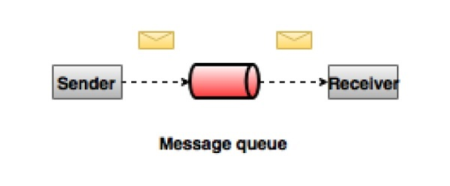
Its all a quest for good Messaging system
The biggest challenge in Bigdata is how to collect large volume of data more efficiently, and accurately
A Messaging System is responsible for transferring data from one application to another, so the applications can focus on data, but not worry about how to share it.
Two types of messaging patterns are available − one is point to point and the other is publish-subscribe (pub-sub) messaging system. Most of the messaging patterns follow pub-sub.
In a point-to-point system, messages are persisted in a queue. One or more consumers can consume the messages in the queue, but a particular message can be consumed by a maximum of one consumer only.

Slide 3
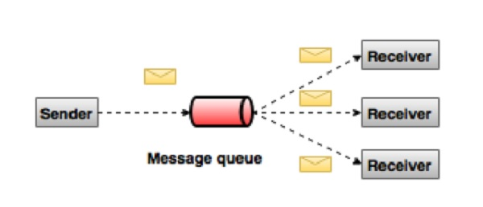
Pub Sub Messaging System
In the publish-subscribe system, messages are persisted in a topic.
Unlike point-to-point system, consumers can subscribe to one or more topic and consume all the messages in that topic.
In the Publish-Subscribe system, message producers are called publishers and message consumers are called subscribers.
The best example is DTH

Slide 4
The quest ends here – KAFKA
Apache Kafka was originally developed by LinkedIn, and was subsequently open sourced in early 2011
It is a distributed publish-subscribe messaging system and a robust queue that can handle a high volume of data and enables you to pass messages from one end-point to another
Kafka messages are persisted on the disk and replicated within the cluster to prevent data loss
Kafka is built on top of the ZooKeeper synchronization service
Reliability − Kafka is distributed, partitioned, replicated and fault tolerance.
Scalability − Kafka messaging system scales easily without down time..
Performance − Kafka has high throughput for both publishing and subscribing messages. It maintains stable performance even many TB of messages are stored.
Kafka uses “Distributed commit Log” which means messages persist on disk as fast as possible.

Slide 5

Example !!
Client
Source

Slide 6



Example !!
Client
Source
Client
Client
Client

Slide 7




Example !!
Client
Backend
Client
Another
Backend
Client
Client

Slide 8












Example !!
Client
Backend
Client
Another Backend
Another Backend
Client
Another Backend
Client

Slide 9
Terminologies you should know !!
Producer: Application that sends the messages.
Consumer: Application that receives the messages.
Message: Information that is sent from the producer to a consumer through Apache Kafka.
Topic: A Topic is a category/feed name to which messages are stored and published
Topic partition: Kafka topics are divided into a number of partitions, which allows you to split data across multiple brokers.
Brokers : Brokers are simple system responsible for maintaining the pub-lished data. Each broker may have zero or more partitions per topic. Assume, if there are N partitions in a topic and N number of brokers, each broker will have one partition.
Consumer Group: A consumer group includes the set of consumer processes that are subscribing to a specific topic.

Slide 10
There are more terminologies to know !!
Offset: The offset is a unique identifier of a record within a partition. It denotes the position of the consumer in the partition
Replicas A replica of a partition is a "backup" of a partition. Replicas never read or write data. They are used to prevent data loss
Leader Leader is the node responsible for all reads and writes for the given partition. Every partition has one server acting as a leader
Follower Node which follows leader instructions are called as follower. If the leader fails, one of the follower will automatically become the new leader. A follower acts as normal consumer, pulls messages and up-dates its own data store.

Slide 11
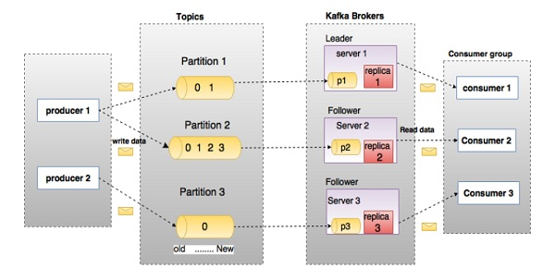
Components of Kafka – How it works ?

Slide 12
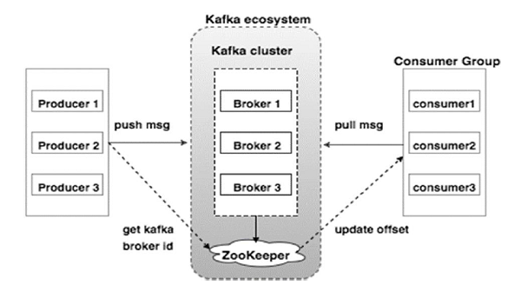
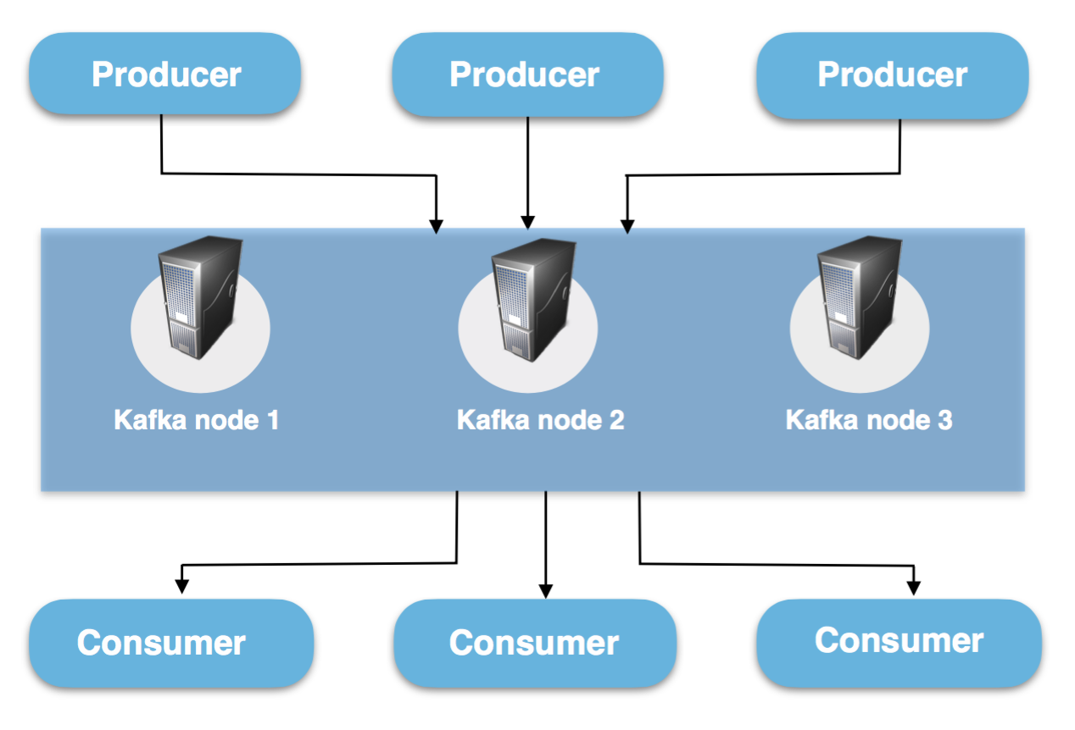
Architecture – High level
A Kafka cluster consists of one or more servers (Kafka brokers), which are running Kafka. Producers are processes that publish data (push messages) into Kafka topics within the broker. A consumer of topics pulls messages off a Kafka topic.

Slide 13
More insights !!
Broker
Kafka brokers are stateless, so they use ZooKeeper for maintaining their cluster state. One Kafka broker instance can handle hundreds of thousands of reads and writes per second without performance impact. Kafka broker leader election can be done by ZooKeeper.
Producers
Producers push data to brokers. Kafka producer doesn’t wait for acknowledgements from the broker and sends messages as fast as the broker can handle.
Consumers
The consumer issues an asynchronous pull request to the broker to have a buffer of bytes ready to consume. The consumers can rewind or skip to any point in a partition simply by supplying an offset value. Consumer offset value is notified by ZooKeeper

Slide 14
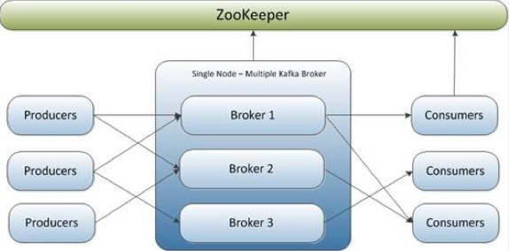
Zookeeper
ZooKeeper is used for managing and coordinating Kafka broker. Kafka stores basic metadata in Zookeeper such as information about topics, brokers, consumer offsets (queue readers) and so on.
ZooKeeper service is mainly used to notify producer and consumer about the presence of any new broker in the Kafka system or failure of the broker in the Kafka system.
As per the notification received by the Zookeeper regarding presence or failure of the broker then producer and consumer takes decision and starts coordinating their task with some other broker.

Slide 15
Offset partition, Replication and Consumer Group
Kafka topics are divided into a number of partitions, which contains messages in an unchangeable sequence. Each message in a partition is assigned and identified by its unique offset.
In Kafka, replication is implemented at the partition level. The redundant unit of a topic partition is called a replica. It's possible for the producer to attach a key to the messages and tell which partition the message should go to. All messages with the same key will arrive at the same partition.
Consumers can join a group called a consumer group. A consumer group includes the set of consumer processes that are subscribing to a specific topic. Each consumer in the group is assigned a set of partitions to consume from. They will receive messages from a different subset of the partitions in the topic. Kafka guarantees that a message is only read by a single consumer in the group.
If the consumer is behind while processing messages, it has the option to eventually catch up and get back to handle data in real time.

Slide 16
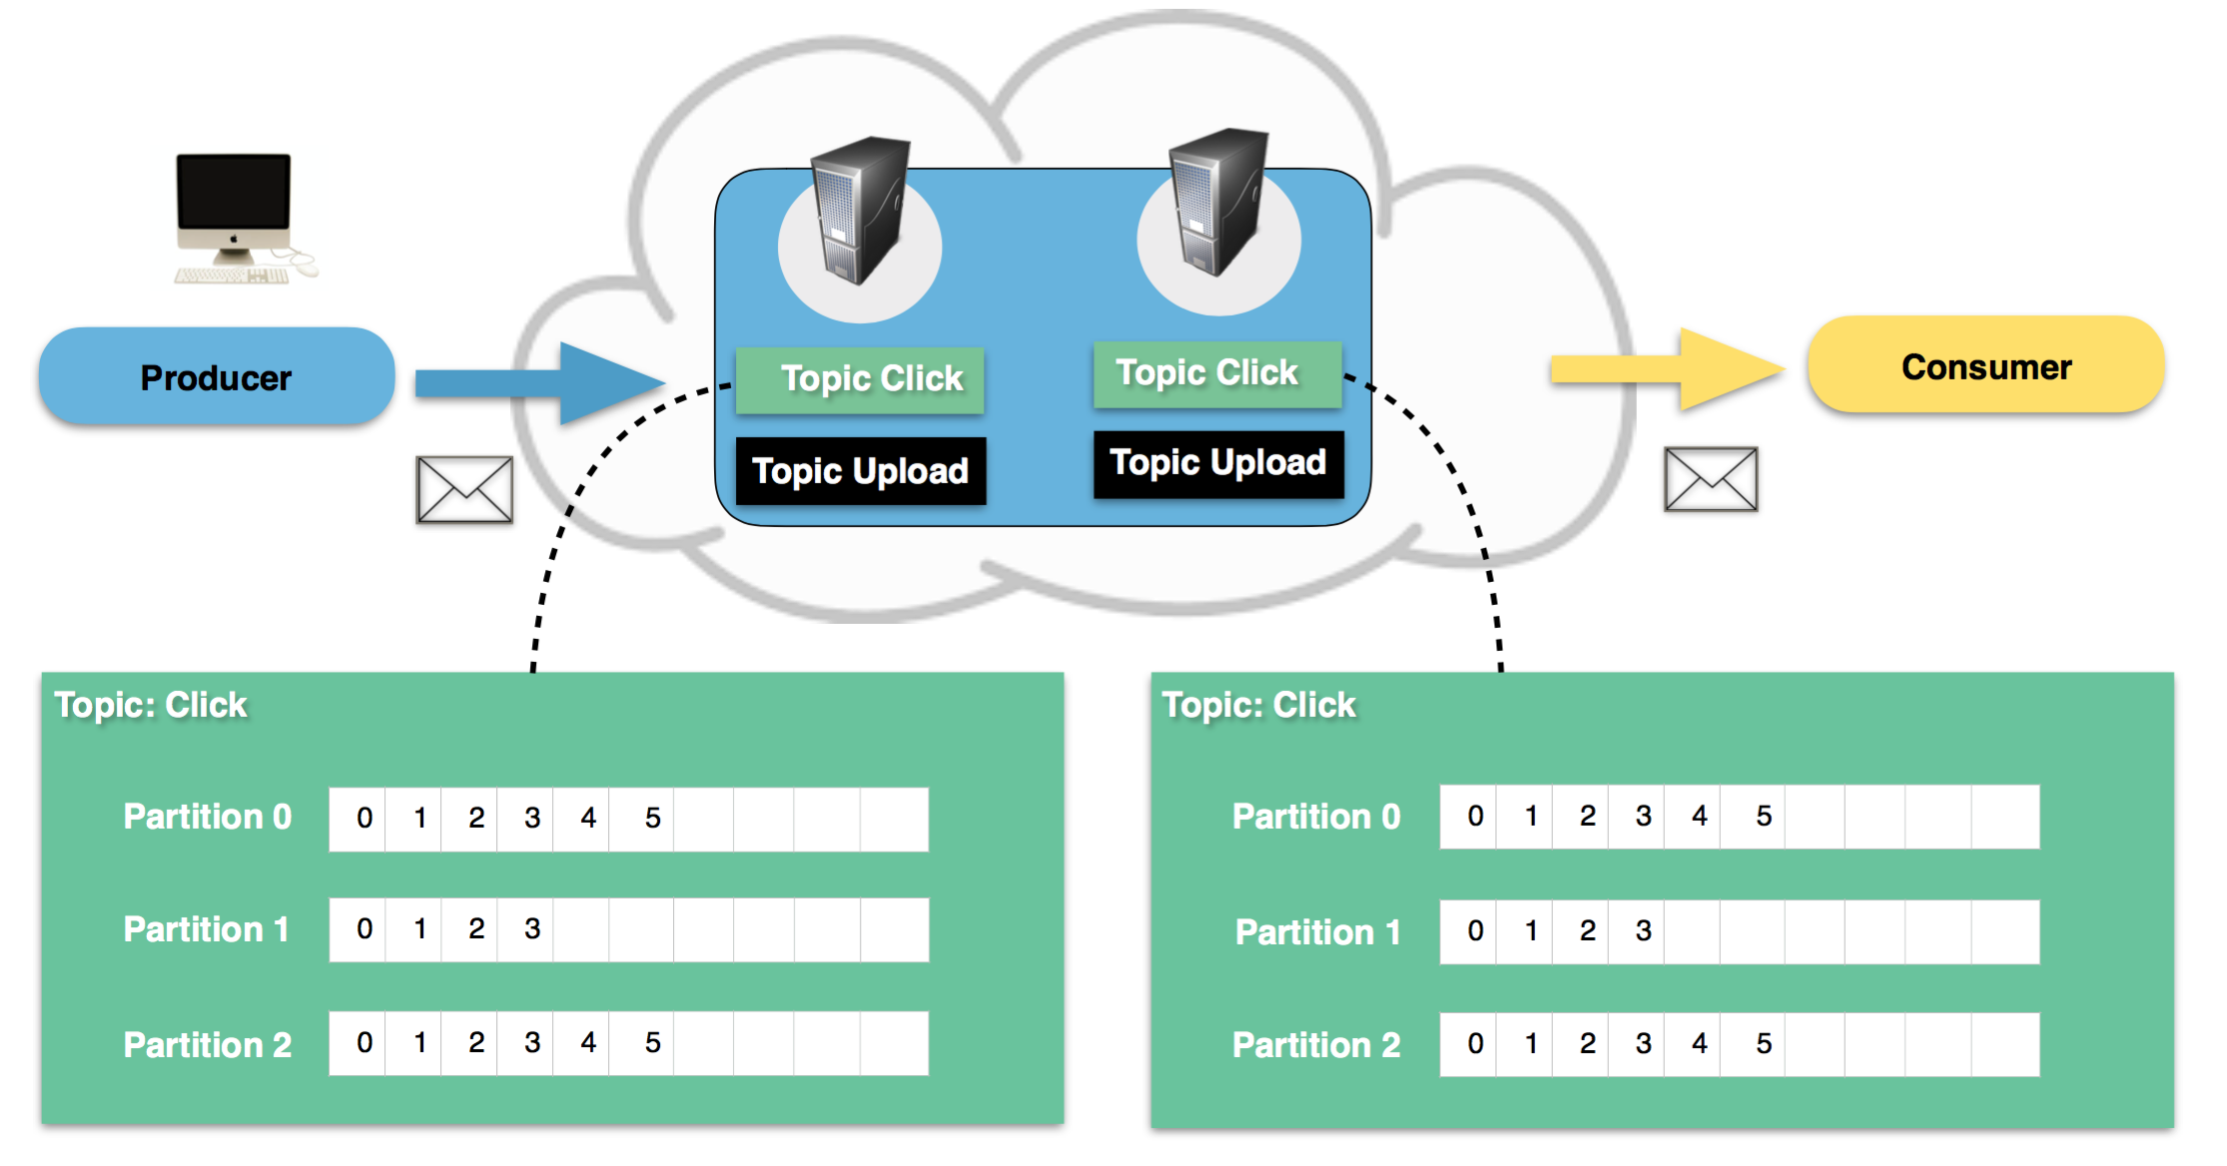
Simple use case – Website Activity

Slide 17
Simple Use case – Website Activity
We will have one topic named "click" and one named "upload".
We will choose to setup partitioning based on the user's id. A user with id 0, will map to partition 0, and user with id 1 to partition 1 etc. Our "click" topic will be split up into three partitions
A user with user-id 0 clicks on a button on the website.
The web application publishes a message to partition 0 in topic "click“
The message is appended to its commit log and the message offset is incremented.
The consumer can pull messages from the click-topic and show monitoring usage in real-time, or it can replay previously consumed messages by setting the offset to an earlier one.

Slide 18
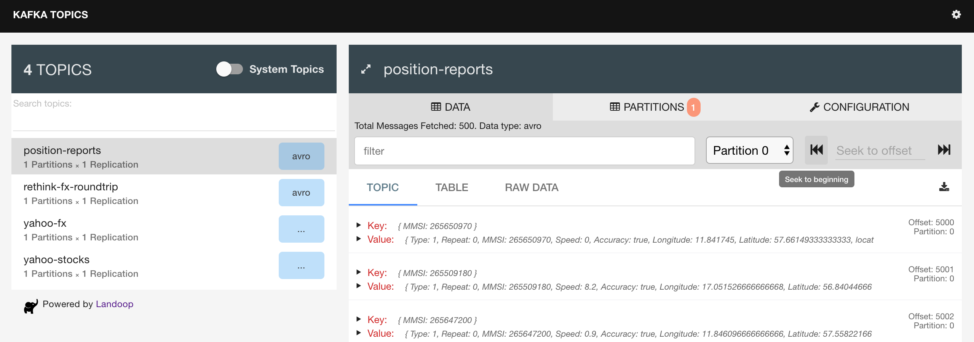
Kafka UI

Slide 19
Commands
List of Topics kafka-topics --list –zookeeper <Zookeeper address>
Create Topic
kafka-topics --zookeeper <Zookeeper Leader> --create --topic <topic name> --partitions 3 --replication-factor 1
Delete Topic
kafka-topics --zookeeper <Zookeeper Leader> --topic <topic name> --delete
Produce Msg
kafka-console-producer --broker-list <broker address> --topic <topic-name>
Consume Msg
kafka-console-consumer --new-consumer --zookeeper <Zookeeper address> --bootstrap-server <broker address> --topic <topic_name>

Slide 20


